Slide 1
S7-1200 communication with WinCC RT Professional

Slide 2
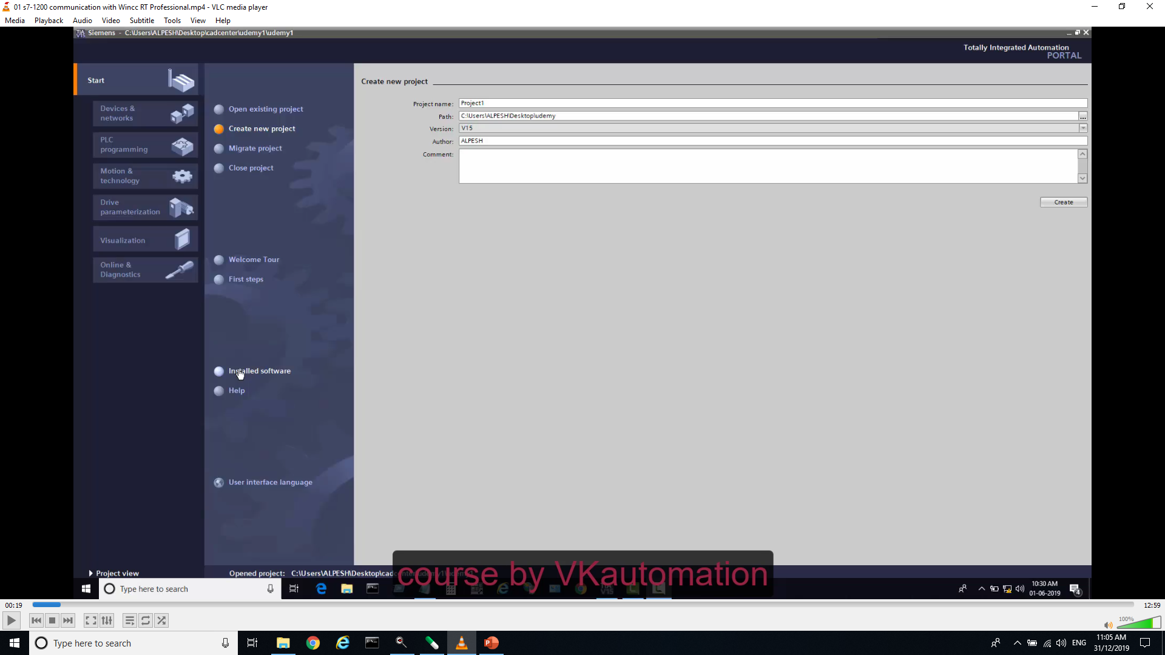
Step 1: Open TIA portal and Create Proect

Slide 3
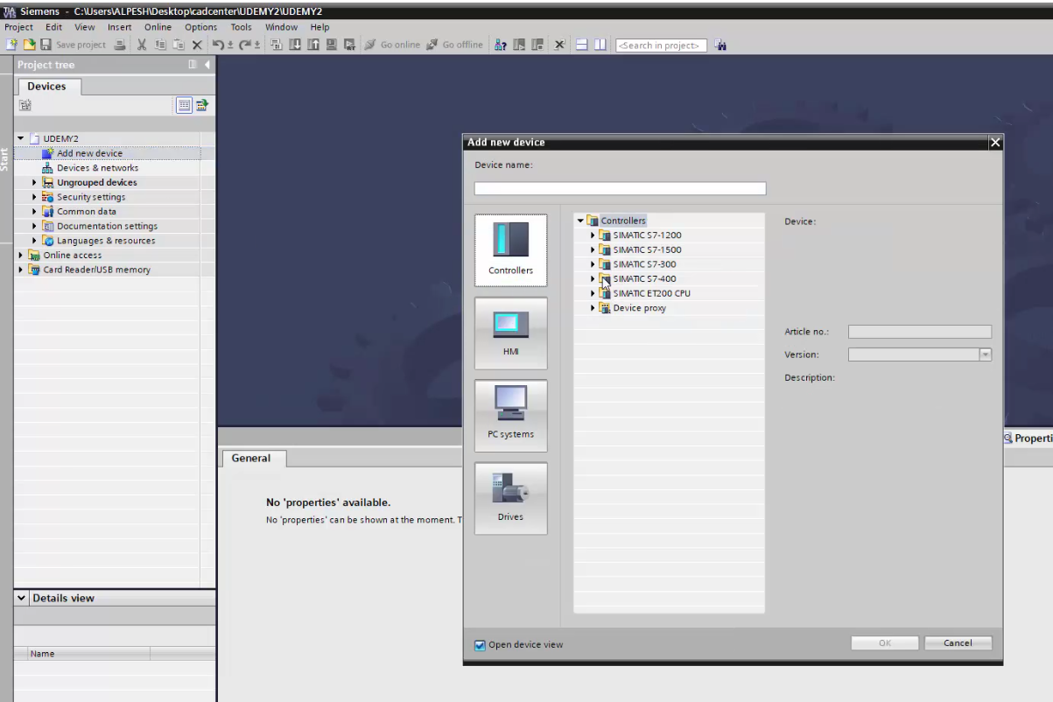
Step 2: Add PLC in our case it is S7-1200 PN

Slide 4
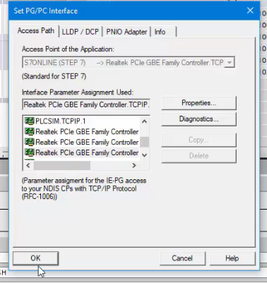
Step 3: Set PG/PC interface from Control Panel as shown in PIC.

Slide 5
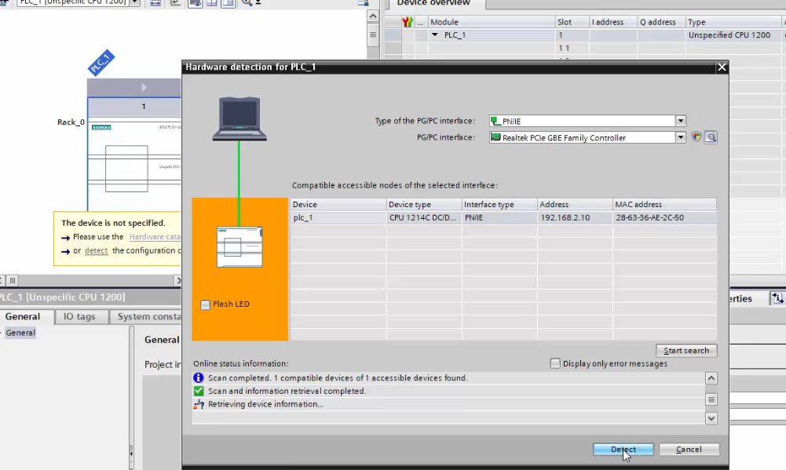
Step 4: Detect PLC from hardware connection using Right IP address

Slide 6
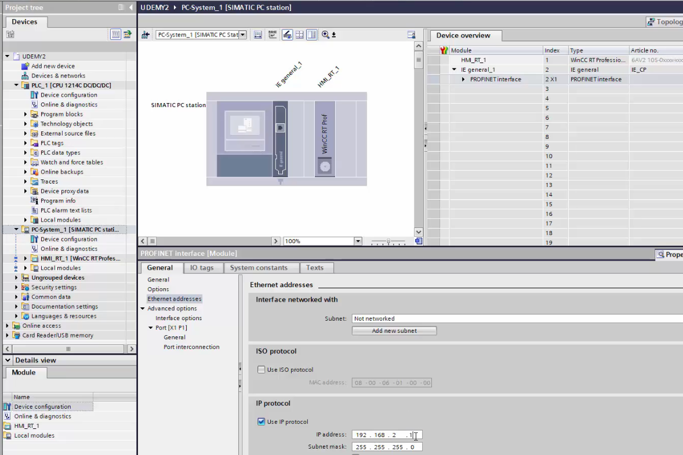
Step 5: Insert PC station and write IP address in range.

Slide 7
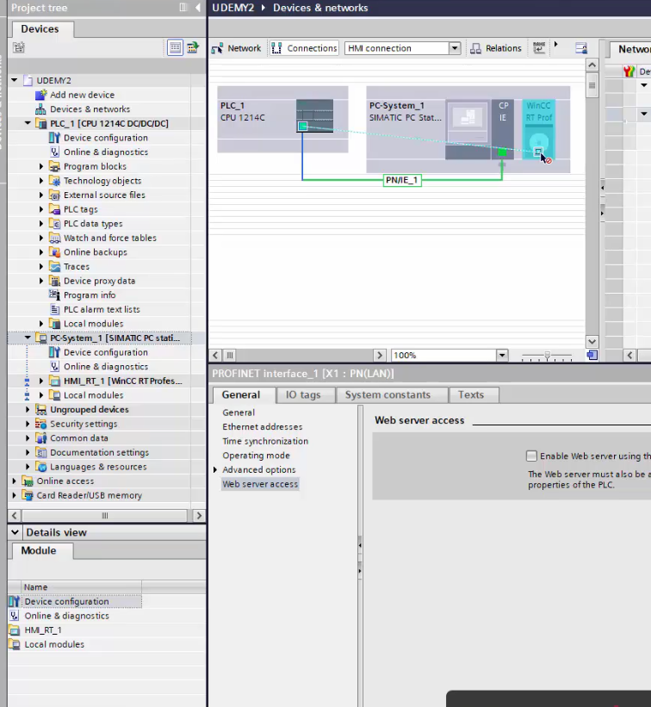
Step 6 : Add HMI connection between PLC and PC station

Slide 8
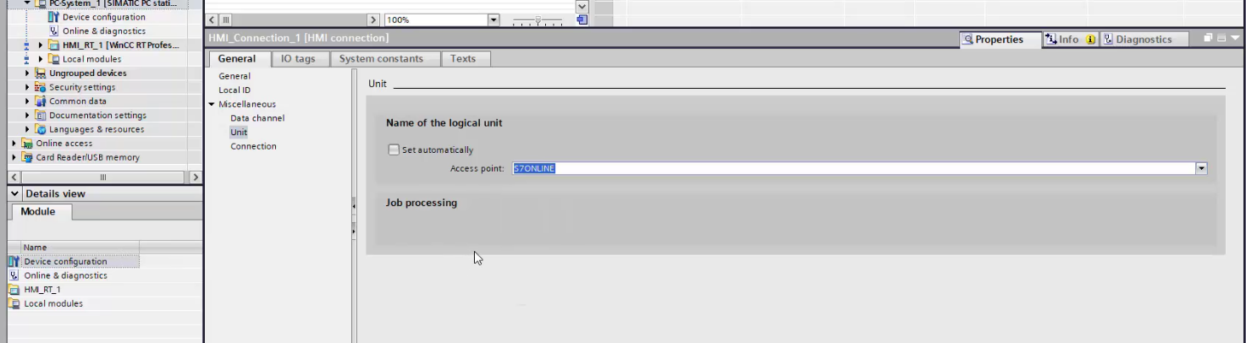
Step 7: Remove “set automatically” and Set “s7-online” access point.

Slide 9
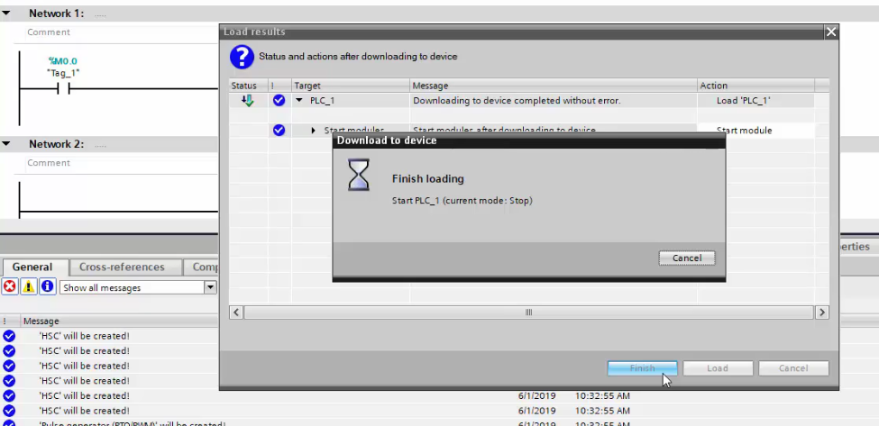
Step 8: Make simple light programme in PLC and Download it
and Design Light In SCADA and Test it.

Slide 10
Thank - You

