Slide 1
User Administration and Component Locking

Slide 2
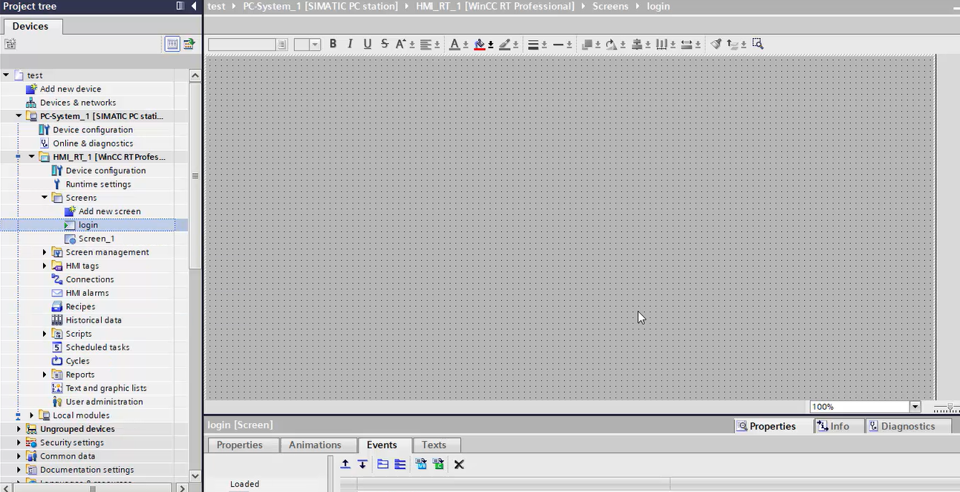
Step 1: Create New Screen “Login”

Slide 3
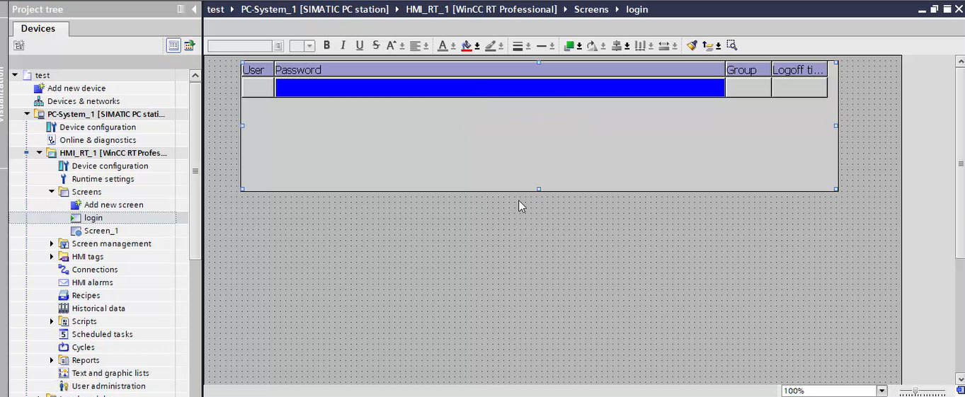
Step 2: Drag and Drop User Administrator tool from right side menu

Slide 4
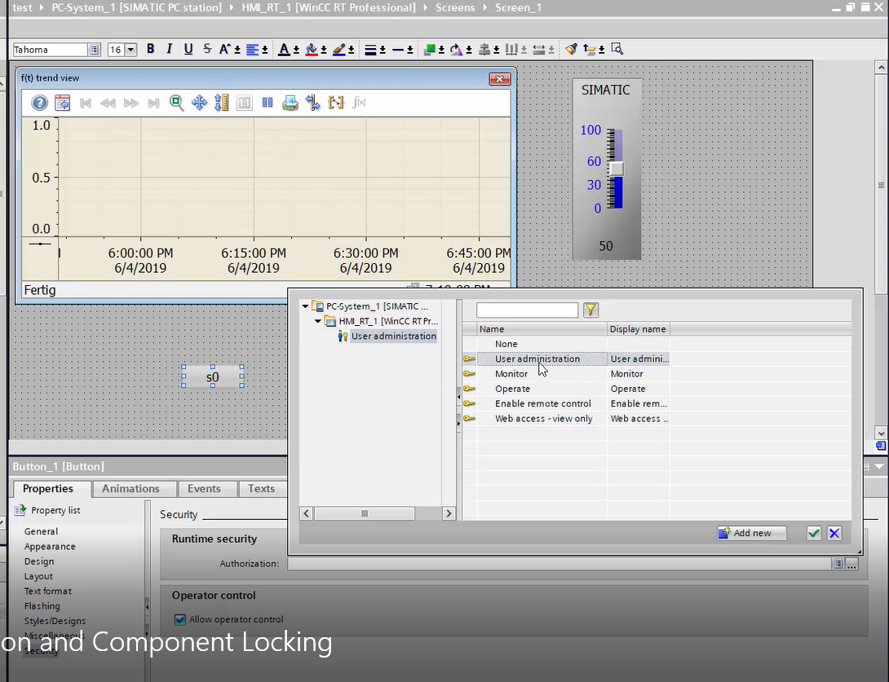
Step 3 : Create Button S0 and S1 with user administration properties

Slide 5
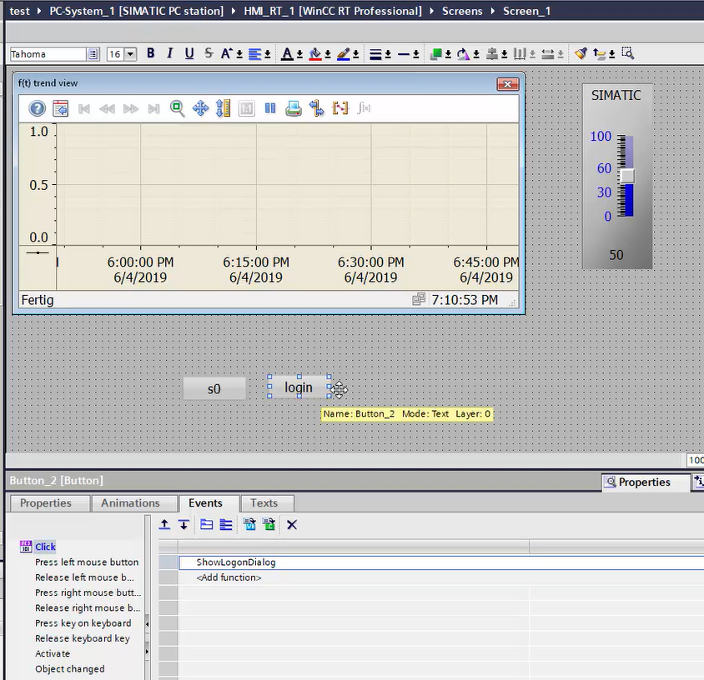
Step 4 : Create button “login” with ShowloginDailog event

Slide 6
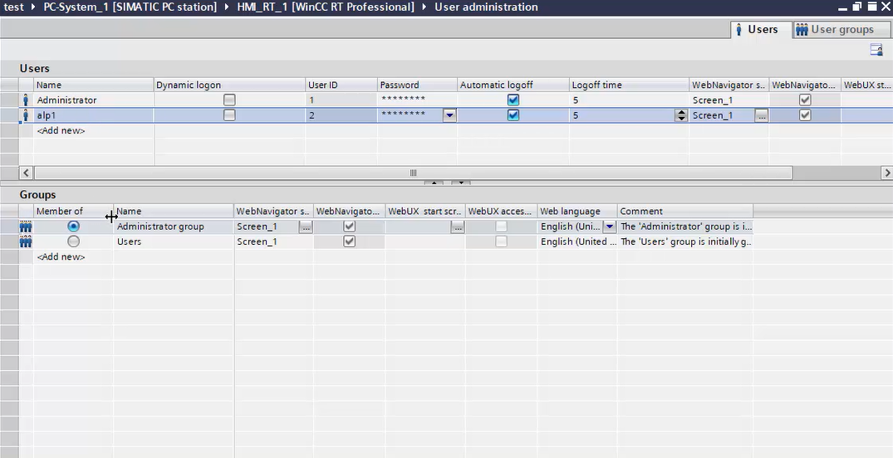
Step 5 : Set User and Password and also set User Group

Slide 7
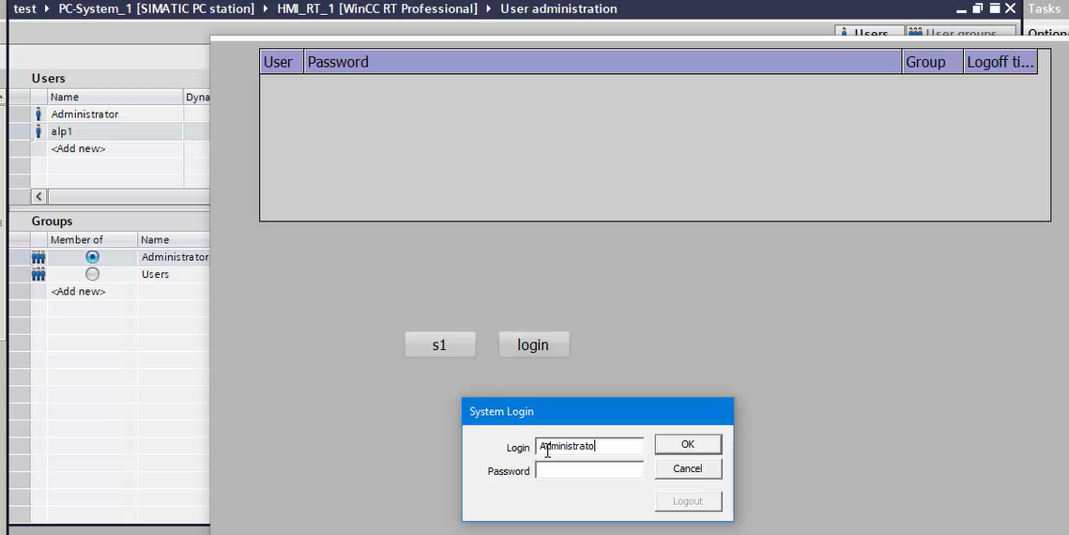
Step 6 : Run programme and enter user and Password. Test Project !

