Slide 1
Channel Diagnosis and Troubleshooting

Slide 2
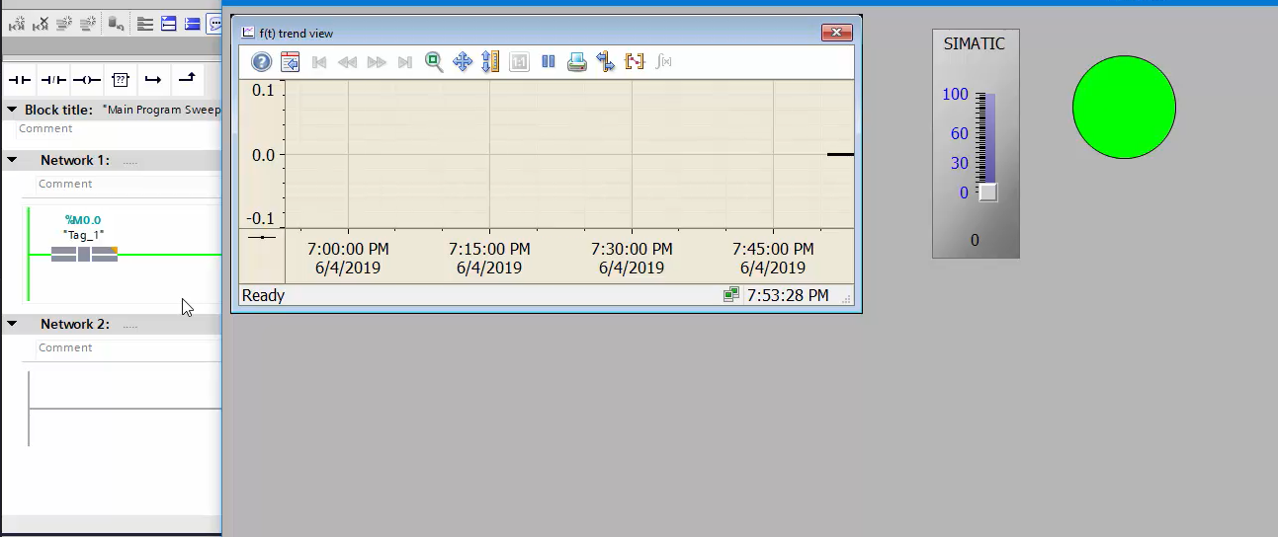
Step 1 : Create One simple Project as shown in Pic. And Run the runtime

Slide 3
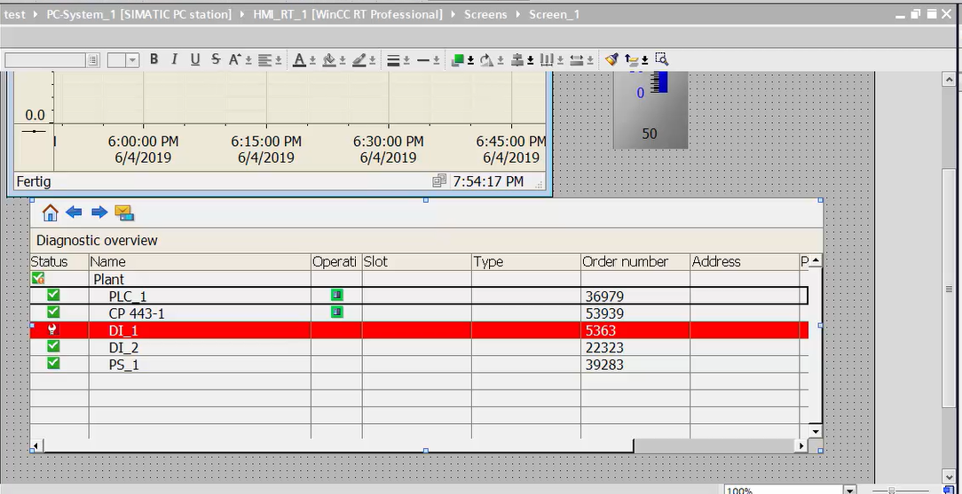
Step 2 : Used Diagnosis Overview Tool available in Right side menu. Drag and Drop tool
in project

Slide 4
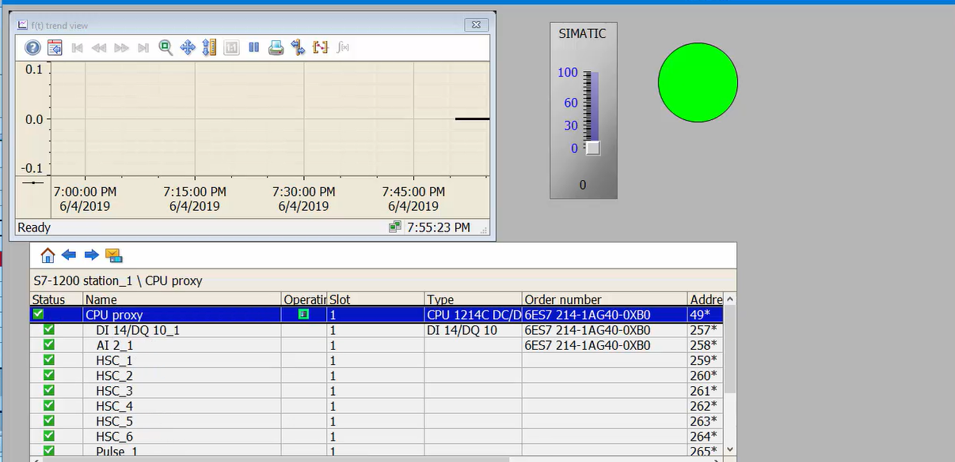
Step 4 : Run the Runtime and Check Simulation.If all configuration is ok
then it will show connected. All tick must be in green in diagnosis overview.

Slide 5
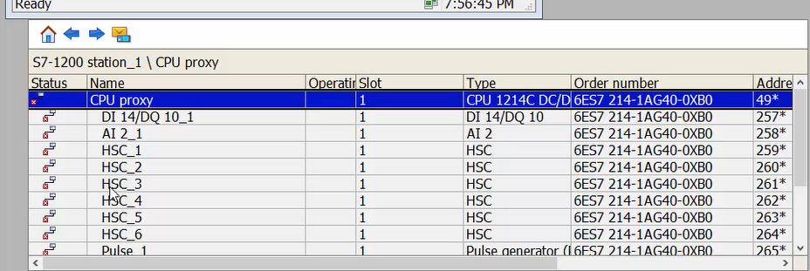
Step 5 : Now remove profinet cable from PLC and It must be disconnected and
all green tick will be converted in Red.

