Slide 1
What is Google Veo3?
Discover the state-of-the-art video model Google Veo3, the first model that’s actually usable

Slide 2
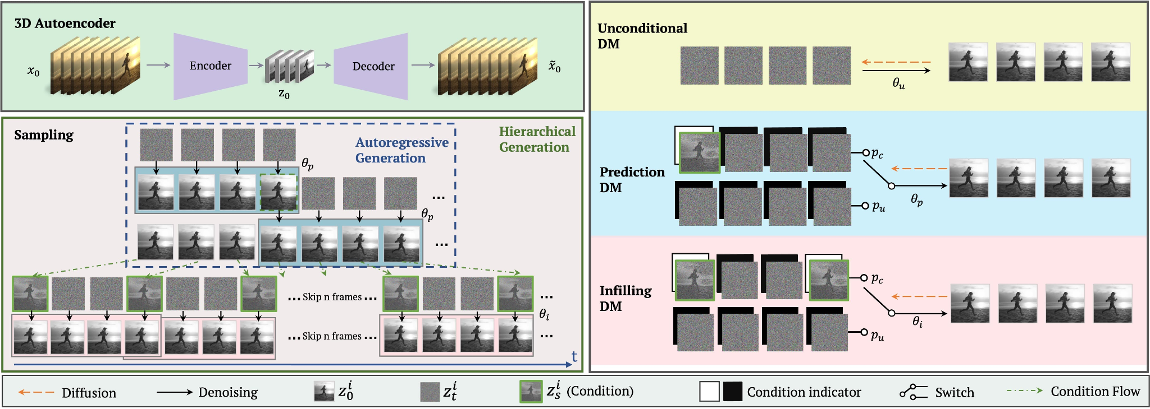
Latent Diffusion Models
Source

Slide 3
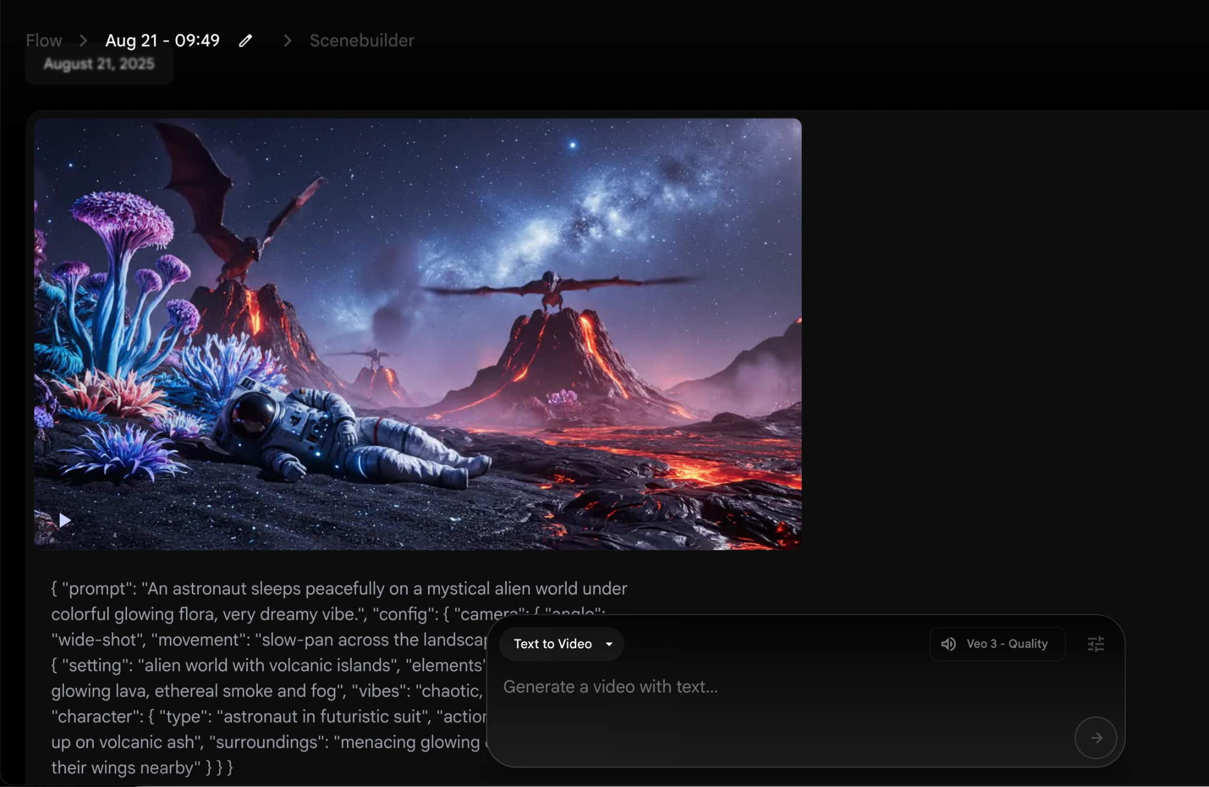
Google Veo3
Created by Google
Access it via flow or via the api, also AI studio

Slide 4
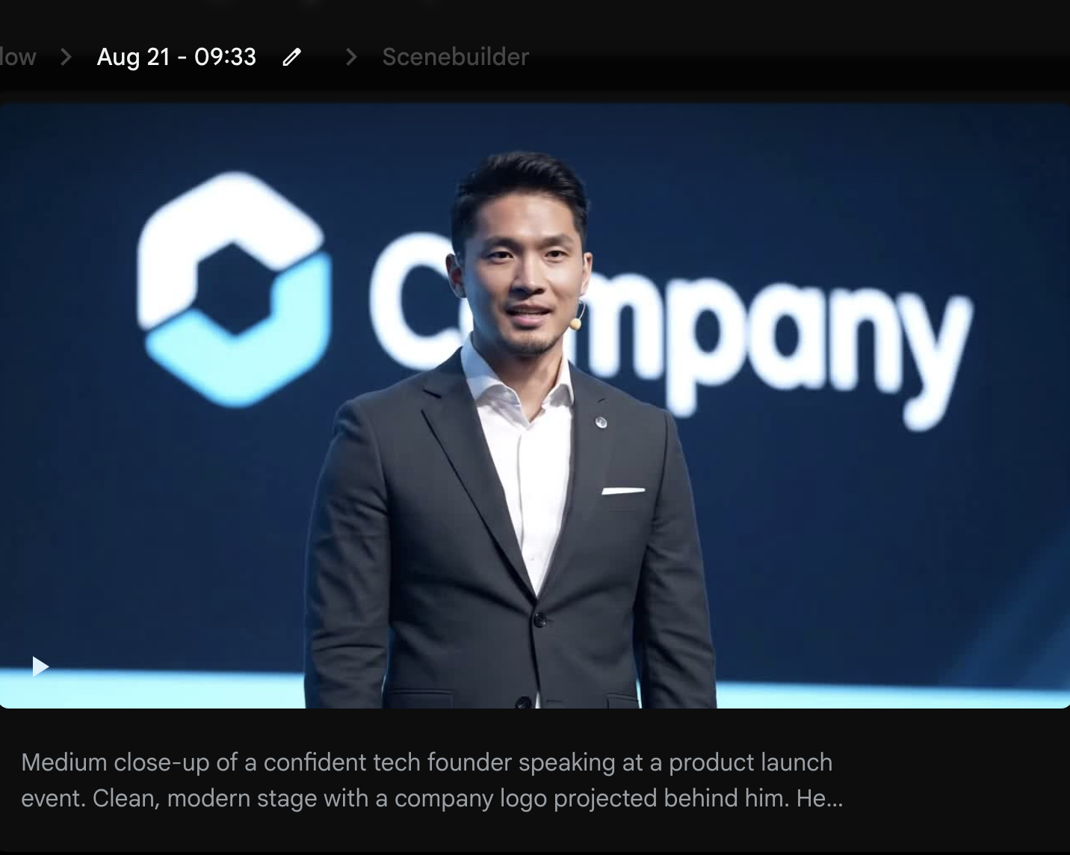
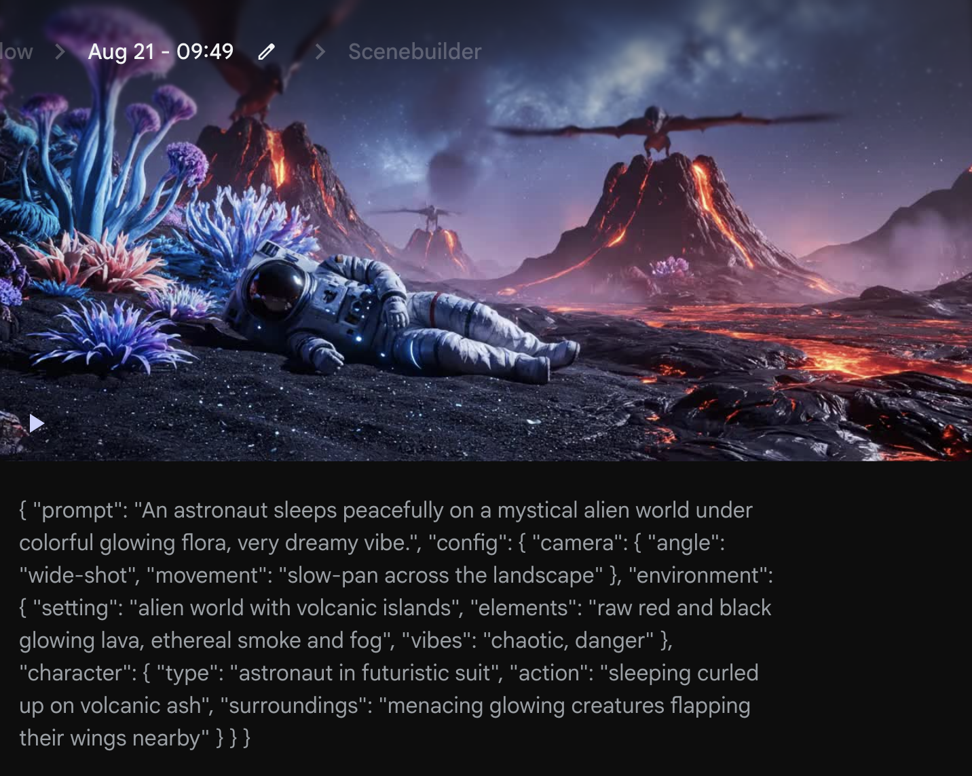
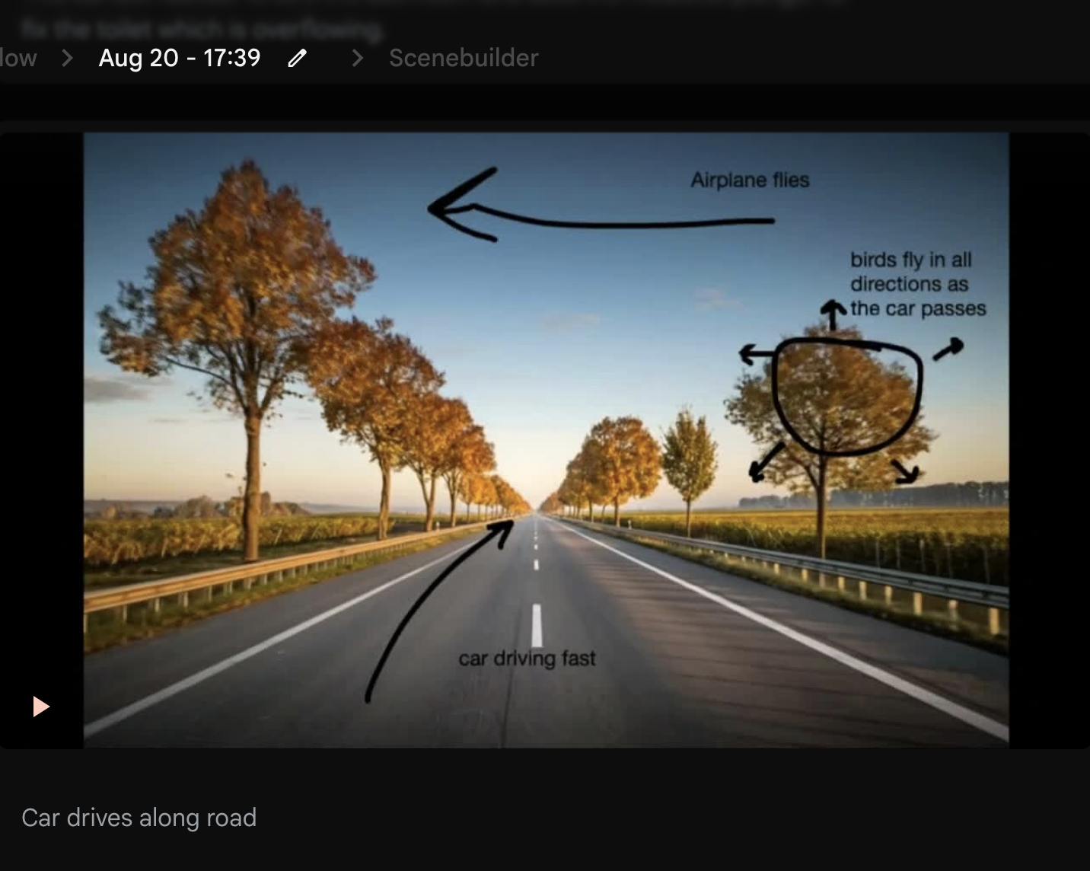
Google Veo3 Features
Realistic Video
JSON Prompting
Annotated Frames

Slide 5
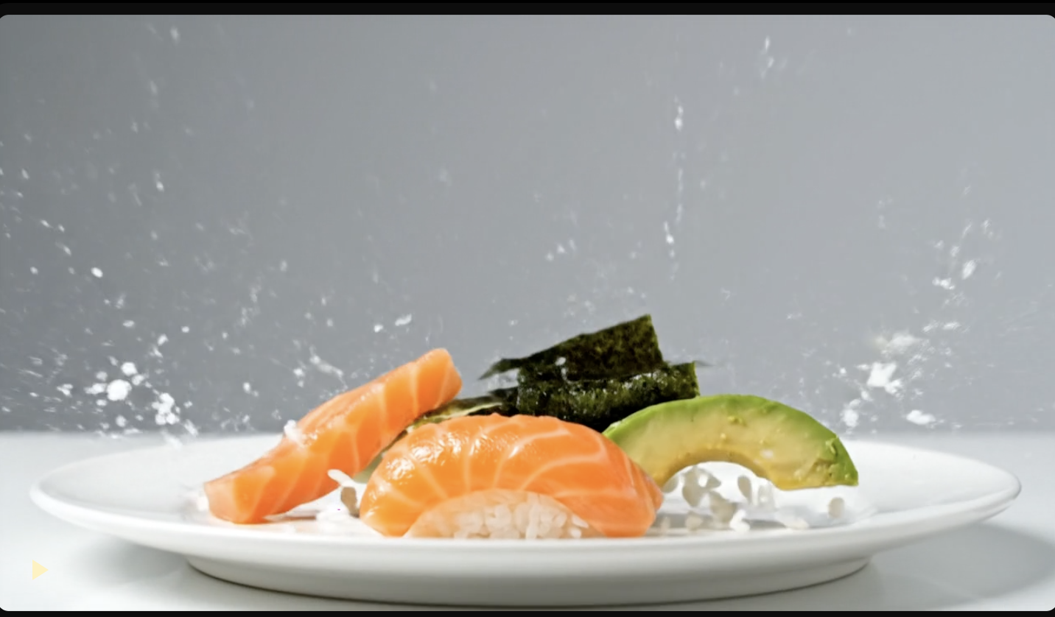
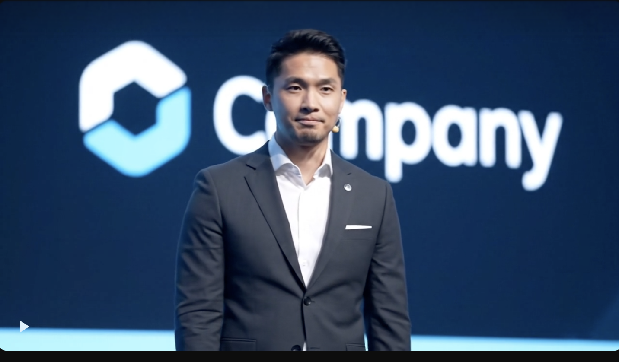
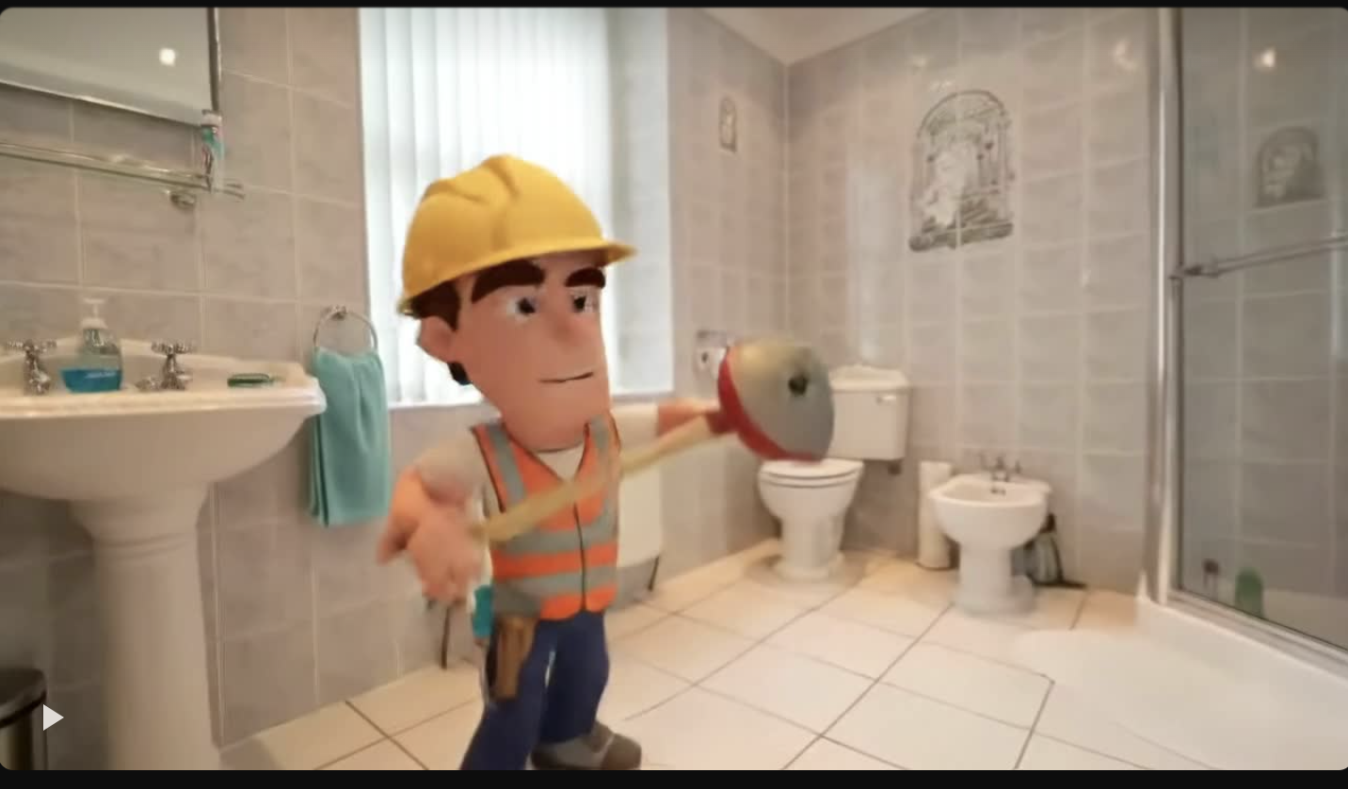
Google Veo3 Use Cases
Ads
Company Videos
Memes

