Slide 1
ALU (Arithmetic Logic Unit) Explained
In this lecture I will explain what an (Arithmetic Logic Unit) ALU is, which is what we will be designing and implementing on our FPGA for Lab 5.

Slide 2


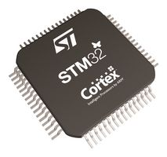
What is an ALU?
-ALU is the piece of a processor that performs all of the logical and mathematical operations.
-The ALU is critical because it determines which mathematical operations your processor supports.
When going through the selection process for a microprocessor in an embedded system some things you may be looking for that the ALU will dictate:
  Number of Floating Point Operations per second
  Number of Multiply and Accumulate Instructions per seconds
  Core size:
    8 bit
    16 bit
    32 bit
    64 bit

Slide 3
Parts of an ALU
Inputs
A: One of the values used to generate the result.
B: One of the values used to generate the result.
Opcode: Determines the operation of the ALU.
Outputs
Result: The output of the ALU, depends on the Opcode input.
Error: Lets the processor know a form of error has occurred. A common error would be an overflow flag.
A
B
Opcode
Result
Error

Slide 4
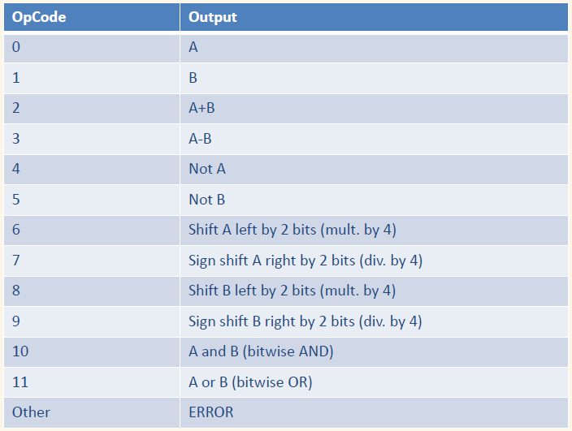
ALU Instruction Set

Slide 5
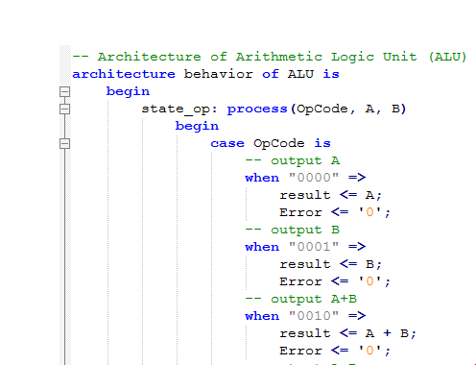
VHDL Representation of an ALU

Slide 6
END
Now that we understand what an ALU is and how it works, lets get started designing one!

