Slide 1
Barrel Shifter Explained
In this lecture I will explain what a barrel shifter is and how we can implement one in VHDL

Slide 2
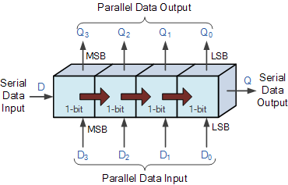
Barrel Shift Register vs. Shift Register
Shift Register
Only shifts 1 bit per clock cycle.
Standard shift registers only shift left or right.
A universal shift register can go either way.

Slide 3
Barrel Shift Register vs. Shift Register
Barrel Shifter
Allows you to shift ‘n’ number of bits on a single clock cycle.
Can shift left or right just the same.
Requires slightly more resources to implement.

Slide 4
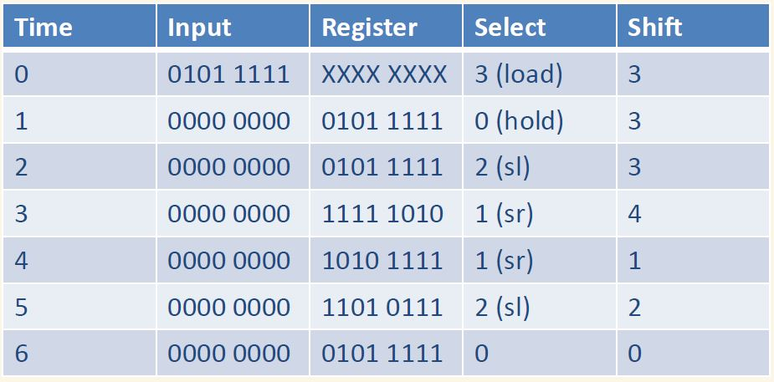
8 bit – Barrel Shifter Example
8 bit
Barrel Shifter
[7:0]
Input
[1:0]
Select
[7:0]
Output
[2:0]
Shift
Reset
CLK

Slide 5
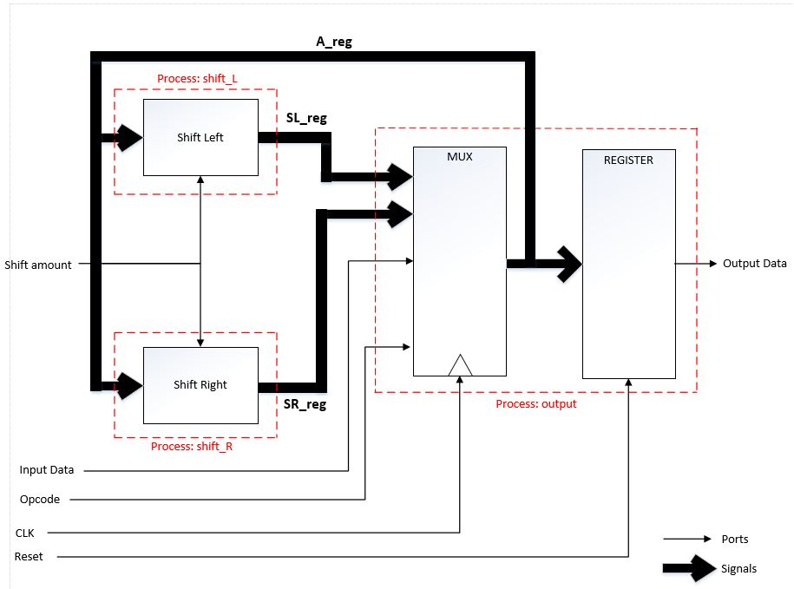
Barrel Shifter Design

Slide 6
END
Now that you have an understanding of how a barrel shifter works, lets get started implementing one on your development board!

