Slide 1
BCD Display Explained
In this lecture I am going to introduce and explain how a Binary Coded Decimal Display works.

Slide 2
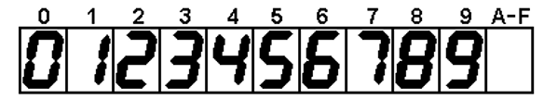
What is Binary Coded Decimal?
A single digit BCD value ranges from 0 to 9.
A traditional binary value will range from 0 to highest number possible with the given number of bits.
BCD is much easier for humans to understand.
Not the most efficient use of bits in a register.

Slide 3
Binary Counter
Example 4 - bit
Binary Counter
Binary Value | Hexadecimal Value | Decimal Value
0000 | 0 | 0
0001 | 1 | 1
0010 | 2 | 2
0011 | 3 | 3
0100 | 4 | 4
0101 | 5 | 5
0110 | 6 | 6
0111 | 7 | 7
1000 | 8 | 8
1001 | 9 | 9
1010 | A | 10
1011 | B | 11
1100 | C | 12
1101 | D | 13
1110 | E | 14
1111 | F | 15

Slide 4
BCD Counter
Example – 4 Bit
Binary Coded Decimal Counter
Binary Value | Hexadecimal Value | Decimal Value
0000 | 0 | 0
0001 | 1 | 1
0010 | 2 | 2
0011 | 3 | 3
0100 | 4 | 4
0101 | 5 | 5
0110 | 6 | 6
0111 | 7 | 7
1000 | 8 | 8
1001 | 9 | 9
XXXX | X | X
XXXX | X | X
XXXX | X | X
XXXX | X | X
XXXX | X | X
XXXX | X | X

Slide 5
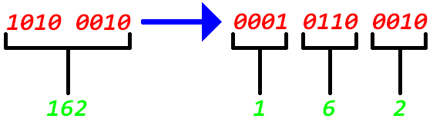
BCD Counter Design
Binary counters are much easier to implement.
However BCD counters are much easier to interpret from a human stand point.
So what will we do?
  Combine them! We will have a standard binary counter that we will then have a design that converts binary numbers to a BCD value!

Slide 6
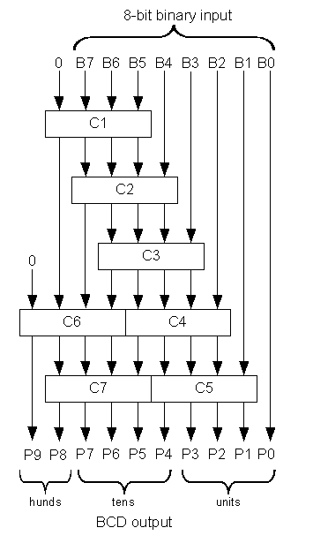
Binary to BCD Design
Use the shift and add 3 algorithm! (8 bit binary number example)
Shift the binary number left one bit.
If 8 shifts have taken place, the BCD number is in the Hundreds, Tens, and Units column.
If the binary value in any of the BCD columns is 5 or greater, add 3 to that value in that BCD column.
Go to 1.

Slide 7
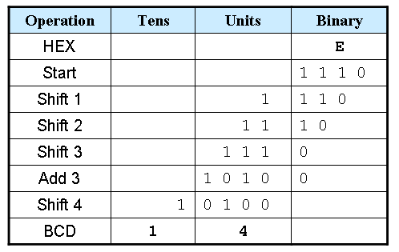
Example – Converting hex 0xE to BCD
<=5

Slide 8
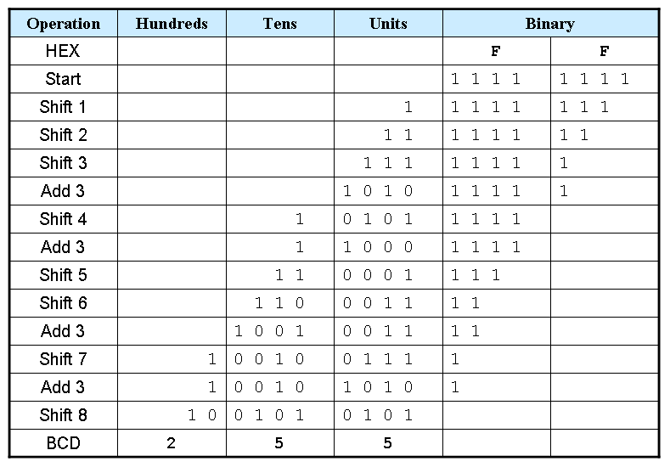
Example – Converting hex 0xFF to BCD

Slide 9
END
Now that you know how a Binary Coded Decimal Counter Works, lets go design one!

