Slide 1
Booth’s Algorithm Explained
In this lecture I will explain how booth’s algorithm works and how to design one in VHDL

Slide 2
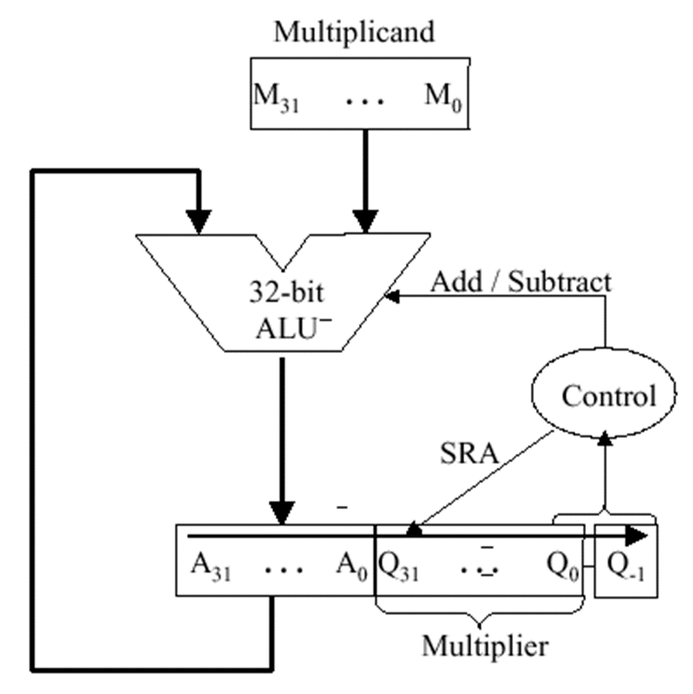
What is Booth’s Algorithm
Booth’s algorithm is a multiplication algorithm that is used to multiply two signed binary numbers in two’s compliment format.
This prevents you from having to use the embedded multipliers / DSP slices located on the chip.
This algorithm includes shifting and addition to perform the multiplication.

Slide 3
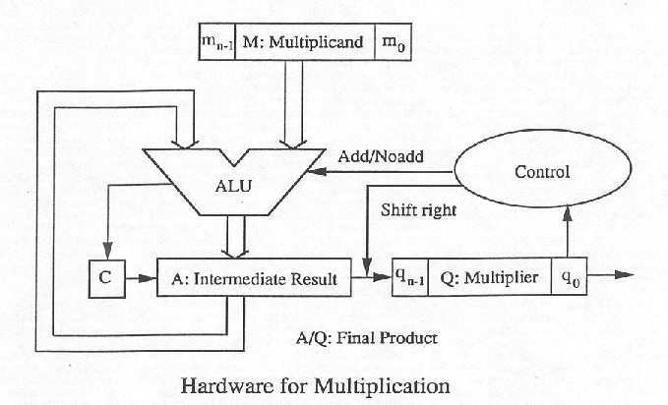
Booth’s Algorithm Setup
Input multiplier and multiplicand are N bits.
Output product is 2N bits.
3 registers used, A, S, and P. All are 2N+1 in size.
The leftmost N bits of A are set to the multiplier, the N+1 rightmost bits are set to 0.
The leftmost N bits of S are set to the 2s comp of the multiplier, the N+1 rightmost bits are set to 0.
The leftmost N bits of P are set to 0, the bits from N to 1 are set to the multiplicand, and bit 0 is set to 0.

Slide 4
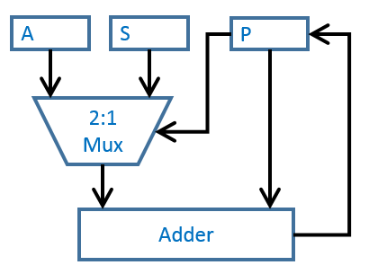
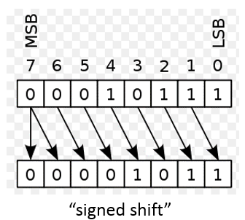
Booth’s Algorithm Steps
Loop through N times:
  – Add A to P if the 2 LSB’s of P are “01”
  – Add S to P if the 2 LSB’s of P are “10”
  – Do nothing otherwise
  – Sign shift P by 1 bit to the right
The left most 2N bits of P is the product

Slide 5
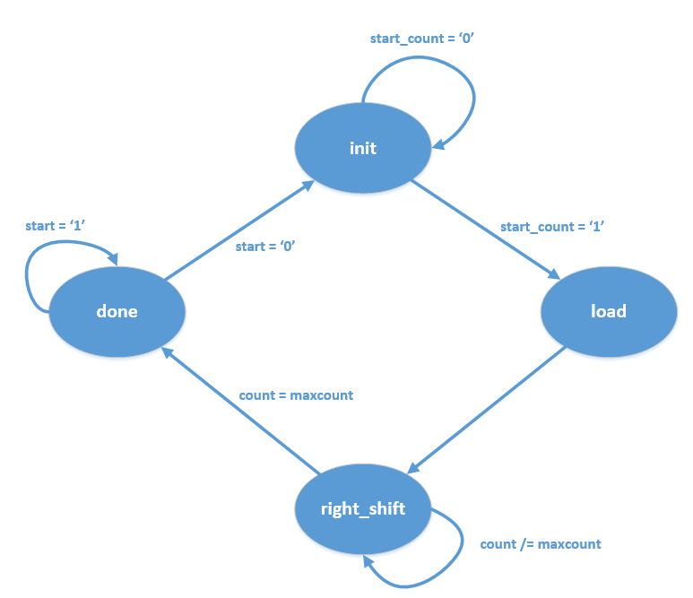
Booth’s Algorithm
State Machine

Slide 6
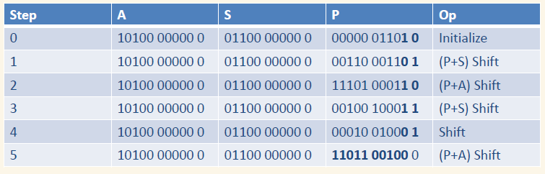
Booth’s Algorithm Example
(5 – bit)
• Multiplier = (10100)2 = -12
• Multiplicand = (01101)2 = 13
• -12 * 13 = -156

Slide 7
END
Now that you understand how Booths Algorithm works, lets go implement this on the development board!

