Slide 1
LCD Design Interface Explained
In this lecture I am going to explain what a character LCD is and how we are going to interface with one using an FPGA.

Slide 2
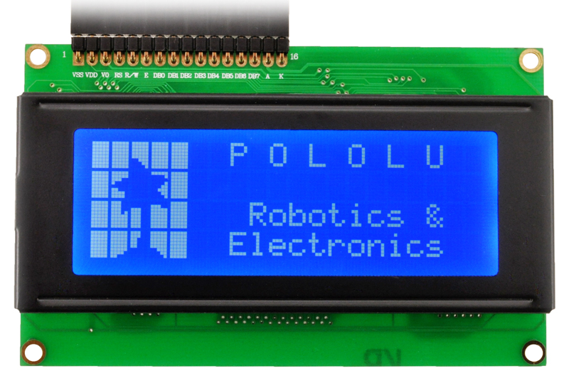
What does LCD stand for?
L – Liquid
C – Crystal
D – Display
We are working with character LCD’s which use characters to display information as opposed to graphic LCDs used to display pictures / video

Slide 3
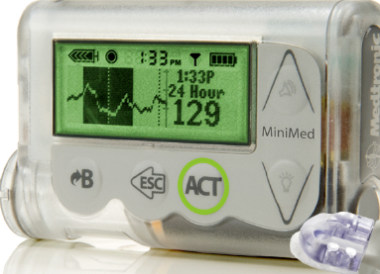
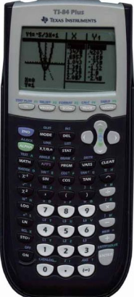
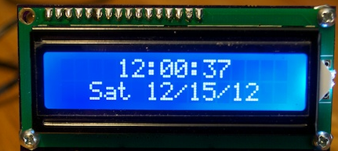
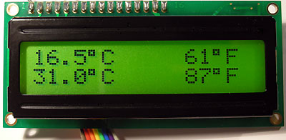
Where are character LCD’s used?
Diabetic Insulin Pumps
Digital Calendars
Digital Clock
Temperature Display’s
Calculators
Many others devices use character LCDs

Slide 4
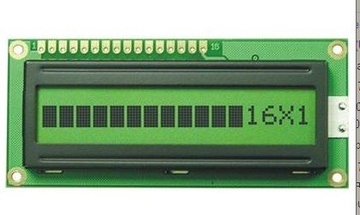
How does a character
LCD work?
Each ‘character’ location has a specific number of dots. By turning certain dots on and off you can generate various characters.
It’s common for LCDs to have built in character sets, you just write a specific value that corresponds to a character in the LCD modules memory.
The LCD module then handles turning specific bits on and off.

Slide 5
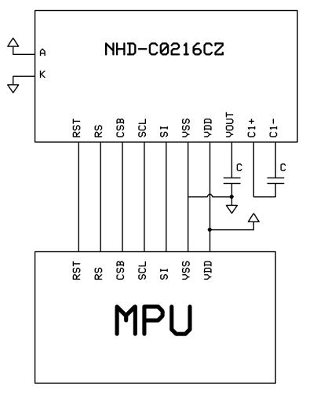
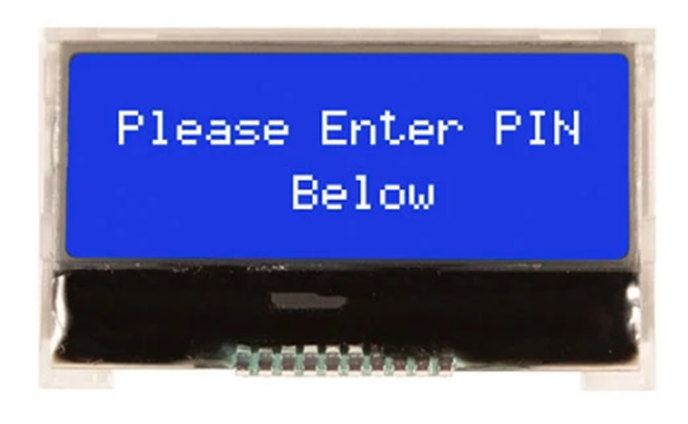
How can we interface with the character LCD?
FPGA

Slide 6
END
Now that you understand how to interface an FPGA with the LCD, lets get started!

