Slide 1
Linear Feedback Shift Register Explained
In this lecture I will walk through and explain how Linear Feedback Shift Registers (LFSR) operate and are used in digital designs

Slide 2
What are LFSR’s used for?
Computers use LFSR’s to generate pseudo random numbers.
Pseudo Random Definition: One of a sequence of numbers generated by some algorithm so as to have an even distribution over some range of values and minimal correlation between successive values.
These pseudo random numbers can then be used for the following things:
  Random Number Generators
  Cryptography
  Communications
  Instantiations of fast counters

Slide 3
What is a Linear Feedback Shift Register?
A linear feedback shift register is a shift register whose input is a linear function of it’s previous input.
The initial value of the shift register is called the ‘seed’ value.
A well chosen feedback function will make the shift register have a very long cycle and the results will appear to be random.
Allows for a quick counter implementation because shifting is faster than adding in hardware.

Slide 4
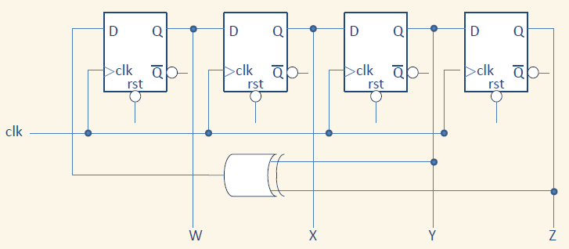
LFSR Design (4 bit) example

Slide 5
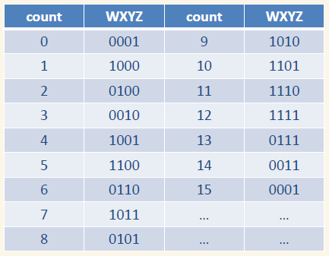
LFSR Design (4 bit) example
- Decimal Values:
  1,8,4,2,9,12,6,11,5,10,13,14,15,7,3
- Only ‘0000’ combination left out
- Uses only 4 registers and 1 XOR gate

Slide 6
END
Now that you understand how Linear Feedback Shift Registers operate, lets start implementing one on your development board.

