Slide 1
Microphone Interface Explained
In this lecture I am going to explain the output from a microphone and how we can read the signals with an FPGA.

Slide 2
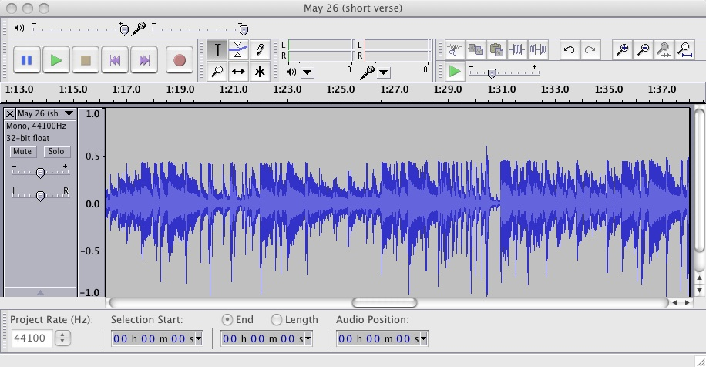
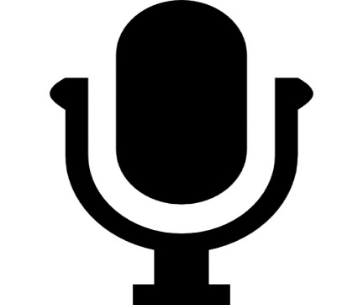
What is a microphone?
I know everybody has heard of a microphone, but what does a microphone physically do?
A microphone is a sound transducer, turning sound waves into a voltage.

Slide 3
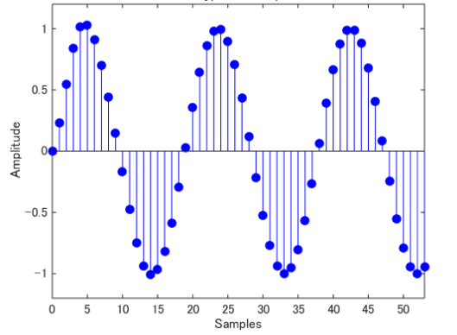
How do we interface a microphone with a FPGA?
Just like the temperature sensor we use an external ADC or an internal one if your FPGA supports that.
The louder the sound the higher the output voltage will be.
By taking samples of the microphone at regular intervals we can gain an idea of what the sound wave looks like.

Slide 4
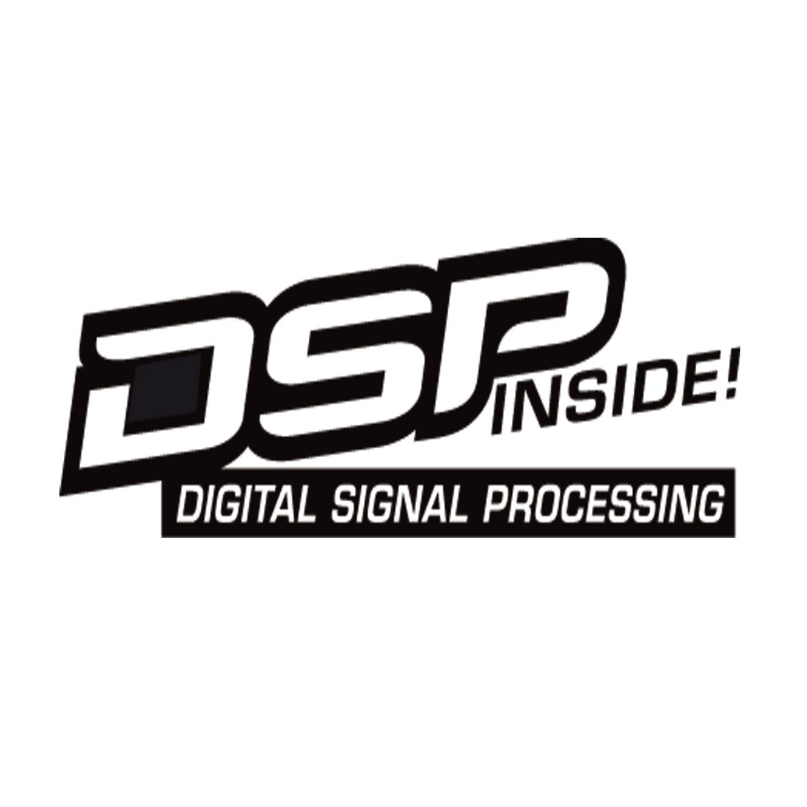
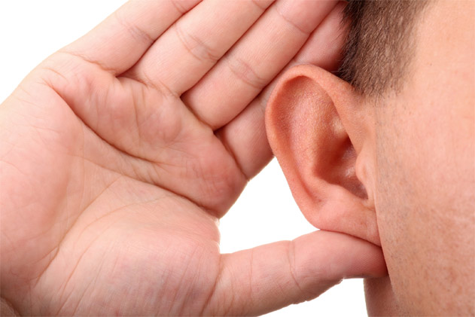
Nyquist Theory
The Nyquist Theorem is also known as the sampling theorem that states you must sample at a minimum of twice the rate of the signal you are trying to accurately sample.
Humans can typically hear from 20Hz – 20kHz so to accurately sample a microphone you must sample at a rate of 40kHz or higher.
44KHz is a common sampling frequency for audio applications

Slide 5
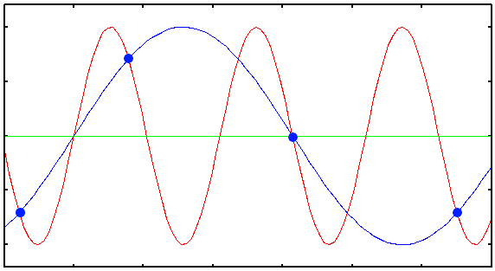
Under sampled Audio
If we under sample the signals we are trying to capture we can’t re-create the signal accurately.
We need to know what the highest frequency of the signal we are trying to capture.
This is called aliasing, were you think the signal is doing one thing but it’s actually doing something else.

Slide 6
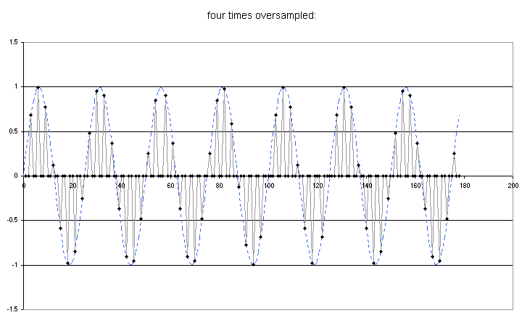
Over sampled Audio
Over sampling is okay, it won’t hurt the quality of your audio signal.
Some people will claim that sampling higher makes the audio much more pure / clear.
It will cost you in processing time, you need to have a fast DSP / Microprocessor / FPGA

Slide 7
END
Now that you know how to interface your FPGA with a microphone, lets get started on the assignment.

