Slide 1
Potentiometer Interface Explained
In this lecture I am going to explain how potentiometers can be interfaced with an FPGA.

Slide 2
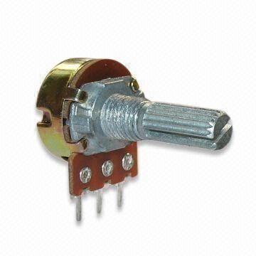
What is a Potentiometer?
Potentiometer’s are variable resistors.
These are analog in nature, so we cannot directly connect the potentiometer to the FPGA I/O pins.
We need to use an ADC (Analog to Digital Controller) to interface the FPGA with the potentiometer.

Slide 3
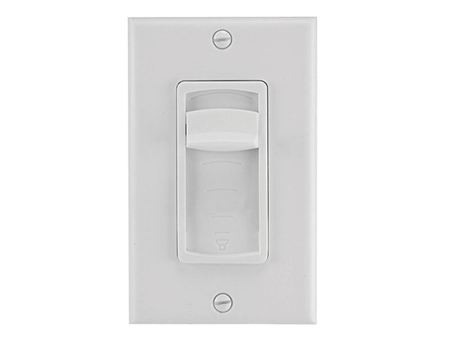
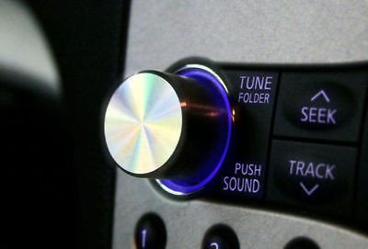
What are Potentiometers Used For?
Any type of analog control such as:
  Audio Volume
  Home Lighting
  Refrigerator Settings
  Etc..

Slide 4
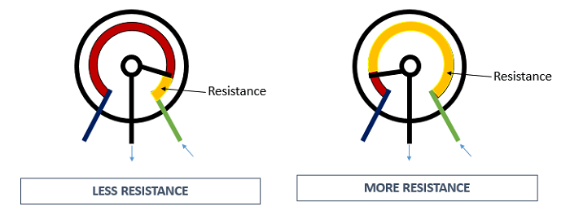
How does a Potentiometer work?
By turning the potentiometer’s knob you will either increase or decrease the resistance of the potentiometer, hence the name “variable resistor”

Slide 5
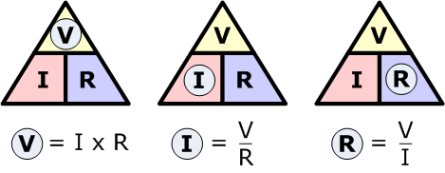
Ohm’s Law
Ohm’s law states: V = IR, where:
V = Voltage (V)
I = Current (A)
R = Resistance (Ω)
When we perform an A/D operation we read the voltage, which changes with the resistance.

Slide 6
END
Now that you understand how potentiometers operate lets get started on the lab!

