Slide 1
Temperature Sensor Interface Explained
In this lecture I am going to explain how various temperature sensors work as well as how to interface your FPGA development board to a temperature sensor.

Slide 2
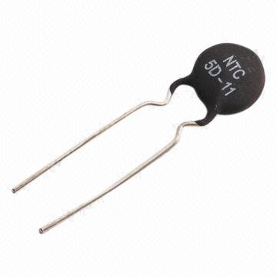
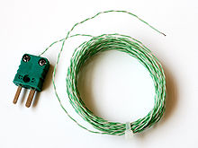
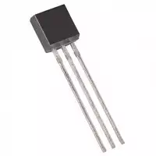
Various Temperature Sensors
There are various sensors that are used to measure the temperature, where each option has advantages / disadvantages compared to other sensors.
Several common sensors are:
Thermistors
Thermocouples
Temperature IC’s
  Digital Interface
  Analog Interface

Slide 3
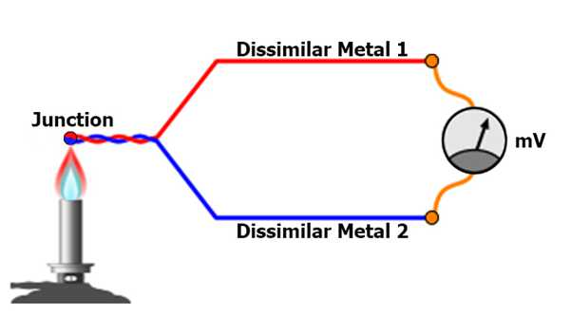
Sensor Operation
Thermistor
A “temperature changing resistor” as the temperature goes up or down the resistance goes up or down.
Thermocouple
- Various types of thermocouples, but generally speaking
Temperature IC’s
- Similar to a thermistor, however the IC puts out a digital or analog signal that linearly relates to the temperature of the IC.

Slide 4
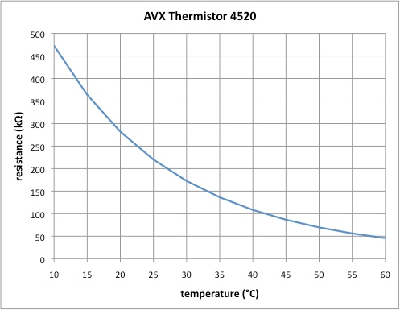
Thermistor
Typically placed on PCB’s to indicate if the board is getting to hot.
Very accurate over a set temperature range.
Resistance is non-linear in relation to temperature.
Need to use an Analog to Digital Converter to measure voltage across resistor.

Slide 5
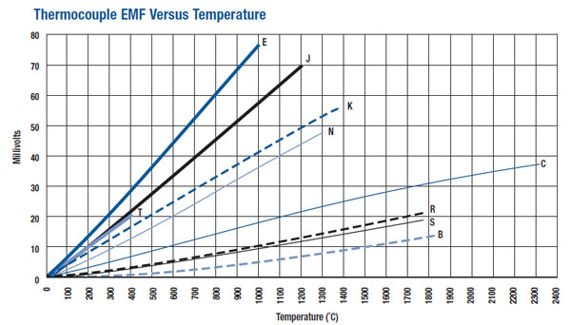
Thermocouple
Typically used to measure temperatures that are extremely hot or extremely cold.
Very commonly used when running tests and you want to see how hot or cold something is getting.

Slide 6
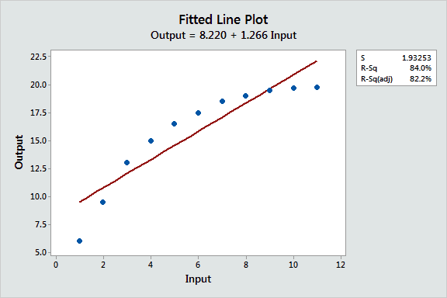
Temperature IC
Placed on PCB boards to be used in measuring the ambient temperature around them.
Similar to a thermistor, except that they typically have a linear output.
They are less accurate than thermocouples or thermistors, they are just easier to interface with.

Slide 7
How to interface your FPGA with a Temperature IC?
Digital Interface
Communicate directly with the IC using the datasheet for instructions.
Analog Interface
Convert the analog signal to a digital signal using an external ADC or the internal ADC if your FPGA device contains one.

Slide 8
END
Now that you understand how a temperature sensor operates and ways you can interface them with an FPGA, lets get started on the lab.

