Slide 1
Tilt Sensor Interface Explained
In this lecture I will explain what a tilt sensor is and how they work.

Slide 2
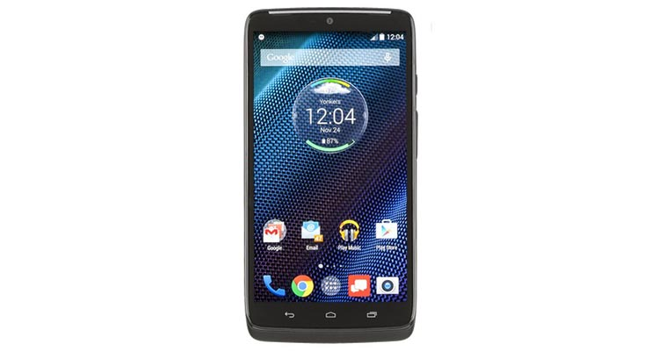


What is a Tilt Sensor?
A tilt sensor simply tells you if something has tilted or is at a specific angle.
Tilt sensors are commonly used in:
Game Machines
Toys
Security Systems
Car Alarms
Etc.

Slide 3

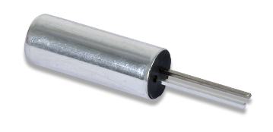
How does a Tilt Sensor work?
When the sensor is tilted the balls inside the sensor will lose contact with the pins.
By connecting the pins of the tilt sensor with a pull-up or pull-down resistor you can interface directly with the tilt sensor.
We will be connecting the FPGA directly to the tilt sensor in the lab assignment.

Slide 4
END
Now that you understand how a tilt sensor works, lets get started on the tilt sensor assignment.

