Slide 1
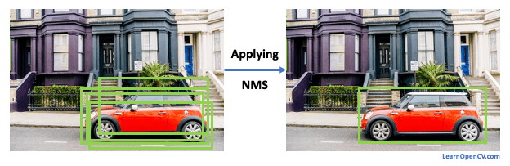
Non Maximum Suppression
Non Maximum Suppression is a technique used to remove redundant or overlapping bounding boxes that may arise from object detection algorithm
Applying
NMS

Slide 2
Non Maximum Suppression
Object Detection on Image
Sort the bounding boxes coordinates based on the confidence score
Start from the bounding box coordinates with the highest confidence score and compare it with all the other bounding boxes of the same class.
If Intersection over Union (IoU) of the two bounding boxes (i.e. overlap ratio) is above a certain threshold, typically represented as “threshold”, then the bounding boxes with lower confidence score is suppressed (removed).
Repeat this process, until all bounding boxes get examined.

Slide 3
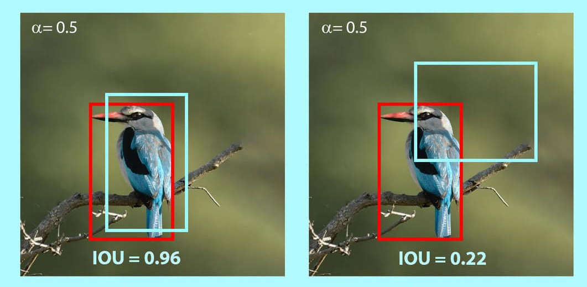
Intersection over Union (IoU)
Intersection over Union (IoU) tells us the percentage of overlap between the ground truth bounding box and the prediction bounding box.
In case of NMS, we find IoU between two predictions bounding boxes.
Threshold
Confidence score = 0.2
Confidence score = 0.8
Confidence score = 0.8
Confidence score = 0.6

Slide 4
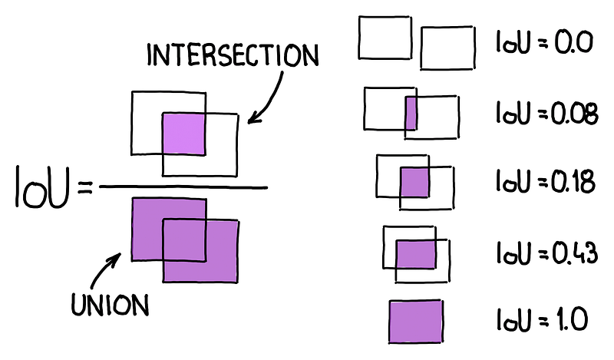

Slide 5
Non Maximum Suppression
Setting a higher “threshold” will result in fewer bounding boxes being suppressed (removed), which may lead to more overlapping bounding boxes being retained.
Conversely, setting a lower threshold will be more aggressive in removing overlapping bounding boxes, potentially leading to fewer but more accurate detections.

