Slide 1
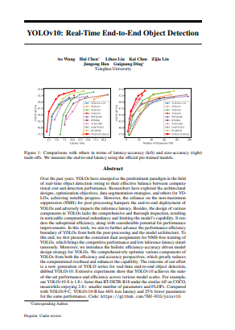
YOLOv10: Real-Time End-to-End Object Detection
YOLOv10 is a real-time object detection model
introduced in the paper, “YOLOv10: Real-Time
End-to-End Object Detection”.
YOLOv10, released in May, 2024 is a new
advancement in the field of real-time object
detection.

Slide 2
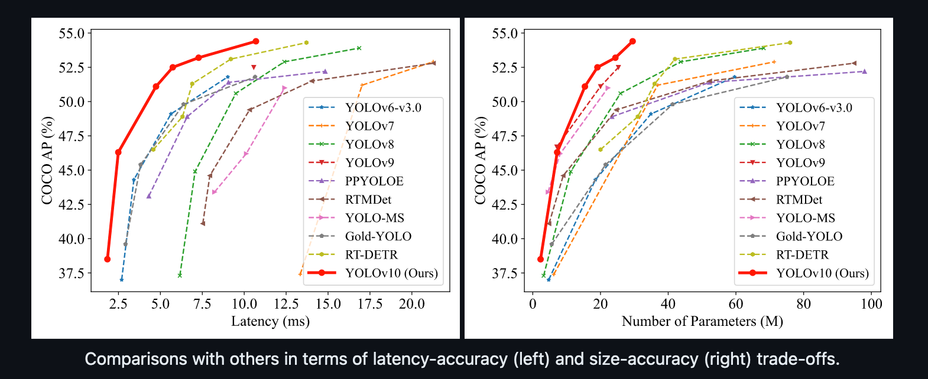
What is YOLOv10
YOLOv10 is a cutting-edge computer vision architecture designed for real-time object detection, building upon the advancements of its predecessors.
YOLOv10 model achieves a higher mean Average Precision (mAP), compared to the earlier YOLO models such as YOLOv9, YOLOv8 and YOLOv7 when benchmarked against the MS COCO dataset.
YOLOv10 model adopt various strategies to tackle the limitations of previous YOLO models, earlier YOLO models rely on NMS for post processing, leading to inefficiencies and increased inference latency. To address these limitations YOLOv10 comes with a consistent dual assignments strategy, which eliminates the need for NMS during inference and significantly reduces the inference latency while maintaining competitive performance.
YOLOv10, incorporates an efficiency-accuracy driven design strategy, which involves optimizing various components of the model to minimize computational overhead and enhance performance.
YOLOv10 Performance

Slide 3
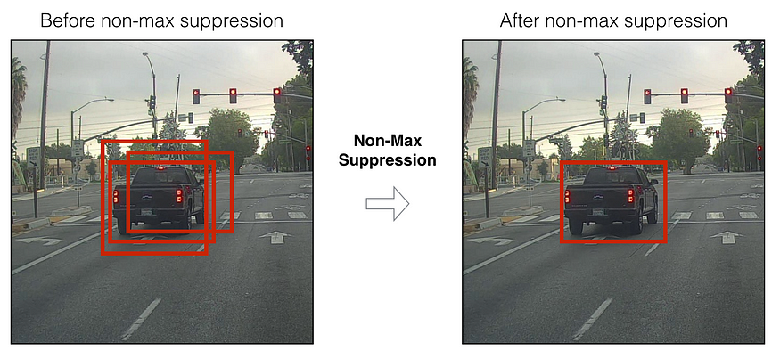
Non Maximum Suppression (NMS)
Non Max Suppression (NMS) is a post processing technique used in object detection to remove the redundant or overlapping bounding boxes, the main aim of NMS is to retain only the bounding boxes with high confidence score and bounding boxes with low confidence score are suppressed or removed.

Slide 4
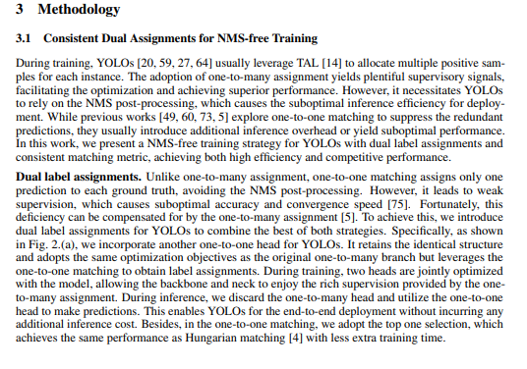
HOW YOLOv10 Works
YOLOv10 introduces a novel training strategy and architectural enhancements. Lets discuss the main components of how YOLOv10 works.
NMS-Free Training Strategy with Dual Label Assignments
Traditional YOLO models employ a one to many assignment strategy during training which makes it necessary to use Non Maximum Suppression (NMS) during inference to filter out redundant predictions/ bounding boxes, leading to inefficiencies and increased inference latency.
To overcome this issue, YOLOv10 adopts a dual label assignment strategy that integrates both one to many and one to one matching approaches.
1. One-to-One Matching: Assigns a single prediction to each ground truth instance, eliminating the need for NMS and enabling end-to-end deployment. This approach typically results in weaker supervision, causing suboptimal accuracy and slower convergence.
2. One-to-Many Assignments: Provides riches supervisory signals but requires NMS for inference.
YOLOv10 cleverly combines these strategies by introducing an additional one-to-one head, mirroring the original one-to-many branch's structure and optimization objectives. During training, both heads are jointly optimized, leveraging the rich supervision from the one-to-many assignments. During inference, the model utilizes only the one-to-one head, thus bypassing the need for NMS and achieving high efficiency without additional inference cost.

Slide 5
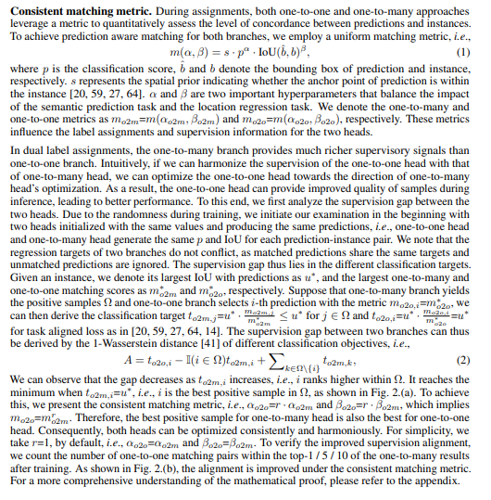
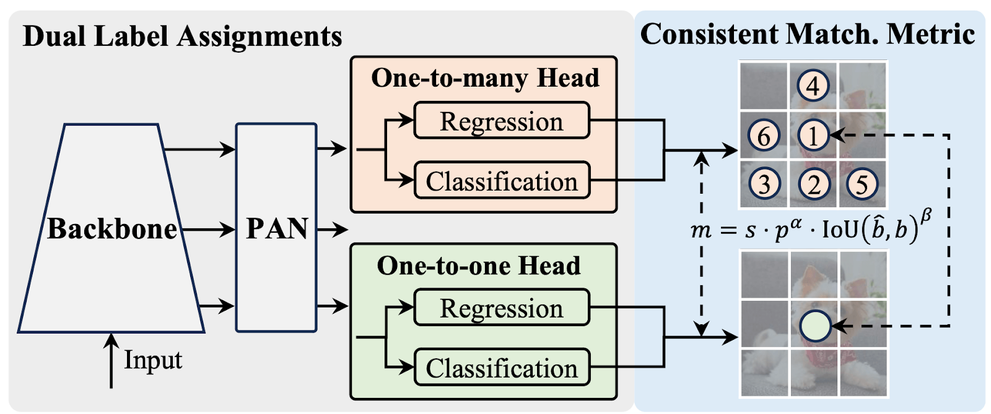
HOW YOLOv10 Works
Consistent Matching Metric
A key component of the dual label assignment strategy is the consistent matching metric used to evaluate the concordance between prediction and ground truth instances.
Consistent dual assignments for NMS-free training

Slide 6
Architecture Enhancements
Classification Head, Decoupled Downsampling, Rank-Guided Block Design
The components of YOLO models consist of the stem, downsampling layers, stages with basic building blocks and the head. The stem incurs minimal computational cost. YOLOv10 thus focuses on optimizing the other three parts enhance efficiency.
Lightweight Classification Head: In YOLOv10, a light weight classification head is designed to reduce computational redundancy, ensuring that the model operates more efficiently.
Spatial-Channel Decoupled Downsampling: Spatial-channel decoupled downsampling is employed to optimize feature extraction, making the process more efficient.
Rank-Guided Block Design: The rank-guided block design further streamlines the architecture, enhancing overall efficiency.
Large-Kernel Convolution: Large – Kernel convolution is utilized to improve the model’s capability to capture detailed features and the effective partial self-attention module boosts accuracy with minimal computational cost.

Slide 7
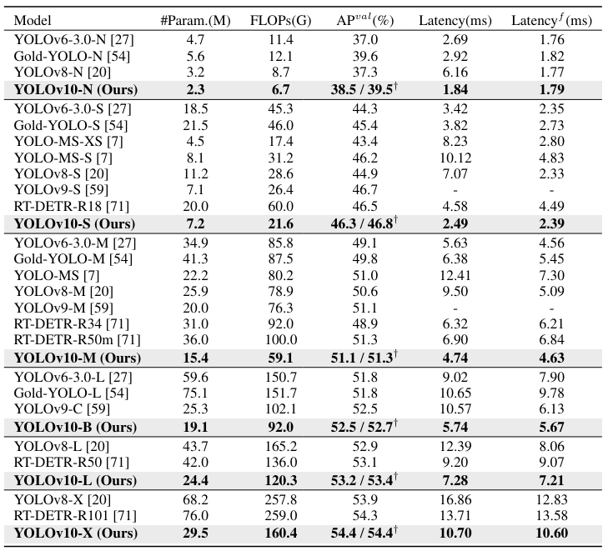
YOLOv10 Performance Comparison
YOLOv10 in comparison to other baseline models like YOLOv8, YOLOv10 demonstrates improvements of 1.2% / 1.4% / 0.5% / 0.3% / 0.5% in Average Precision (AP), with 28% / 36% / 41% / 44% / 57% fewer parameters, 23% / 24% / 25% / 27% / 38% fewer calculations and 70% / 65% / 50% / 41% / 37% lower latencies for N / S / M / L / X variants, respectively.
Comparisons of the real-time object detectors on MS COCO dataset in terms of latency-accuracy (left) and size-accuracy (right) trade-offs, measured using the official pre-trained models for end-to-end latency.

Slide 8
Conclusion
YOLOv10 represents a significant advancement in real-time object detection, achieving state-of-the-art performance in terms of speed and accuracy.
By introducing NMS free training and efficiency-accuracy driven model design strategy, YOLOv10 improves accuracy while reducing computational redundancy and latency.
Comparative analysis against baseline models and other detectors demonstrate YOLOv10’s superiority in Average Precision (AP), parameter efficiency and inference speed.

